Slide 1
Basic controls
Windows Presentation Foundation

Slide 2
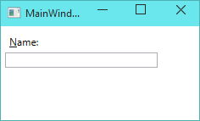

Label
Provide feedforward information
Target: intended control that get focus.

Slide 3
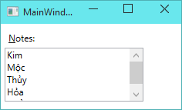
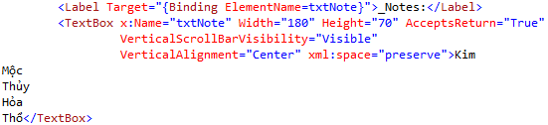
TextBox
AcceptsReturn = True: edit multiple lines

Slide 4
Button
Derive from ButtonBase
Basic control, user can click

Slide 5
Activity
Write XAML code for login screen with Username and Password.

Slide 6
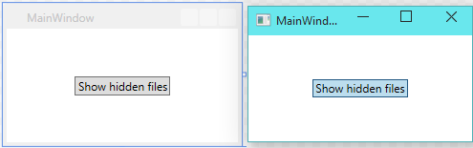
ToggleButton
3 events
Checked when IsChecked is True
Unchecked when IsChecked is False
Indeterminate when IsChecked is null

Slide 7

CheckBox & RadioButton
Derives from: ToggleButton -> ButtonBase
Main property: IsChecked
Normally Checkbox is just ToggleButton with different appearance

Slide 8
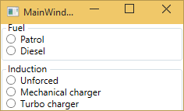
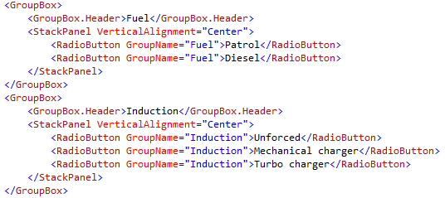
RadioButton – Grouping by name

Slide 9
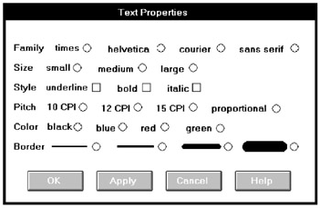
Activity 1 – Problems?

Slide 10
Activity 2 - Improvement
Notes:
<Polyline Stroke="Black" Points="0, 8 70, 8" StrokeThickness="5" StrokeStartLineCap="Round" StrokeEndLineCap="Round"></Polyline>

Slide 11

ComboBox
Enables users to select one item from a list
ComboBox can contain complex items

Slide 12
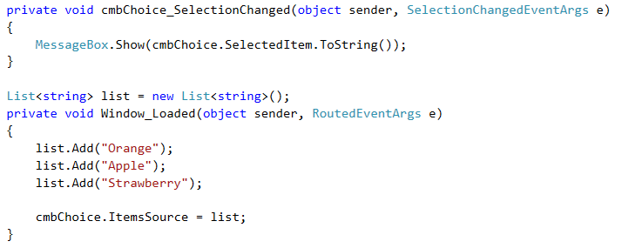
ComboBox – List of string

Slide 13
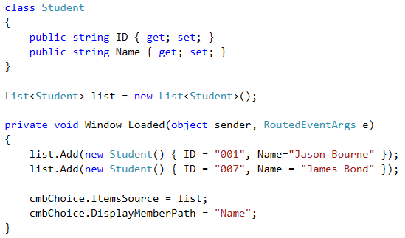


ComboBox - Complex

Slide 14
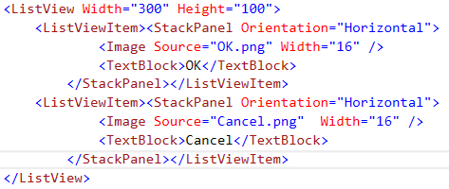
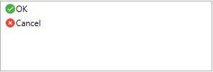
ListView
The ListView control derives from ListBox
It uses the Extended SelectionMode by default

Slide 15

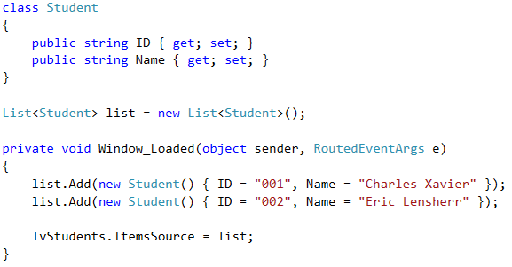
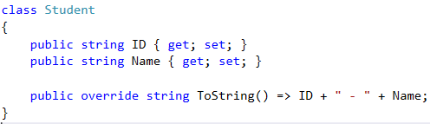


Normal ListView with class

Slide 16
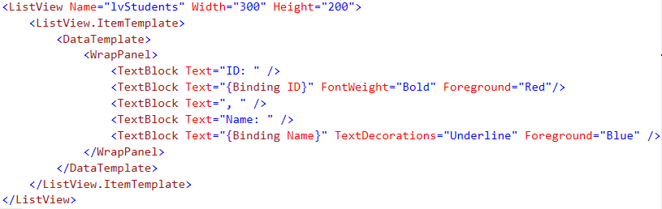

ListView ItemTemplate

Slide 17
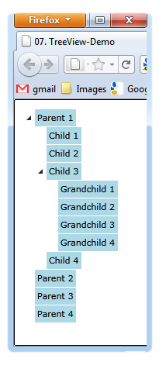
TreeView
Presents a hierarchical view
Data with nodes that can be expanded and collapsed
Important events:
Expanded
Collapsed
Selected
Unselected

Slide 18

GroupBox & Expander
Both provide a container for arbitrary content and a place for a header on top
Expander can be expanded and collapsed
GroupBox always shows its content
Both controls derive from HeaderedContentControl

Slide 19
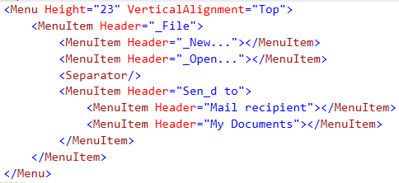
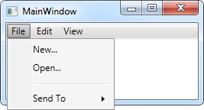
Menu

Slide 20

MenuItem is a headered items control
The Header is actually the main object
MenuItem contains properties for customizing
Icon
IsCheckable
InputGestureText
Can handle events or assign a command to MenuItem’s Command property

Slide 21
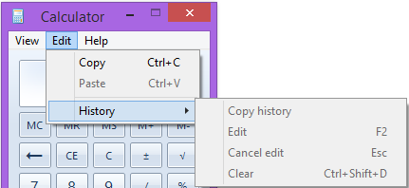
Activity
Create XAML code for this menu

Slide 22
ContextMenu
Works just like Menu
It’s a simple container designed to hold MenuItems and Separators
Must attach it to a control via ContextMenu property
When a user right-clicks on the control the context menu is displayed
<ListBox>
<ListBox.ContextMenu>
<ContextMenu> … </ContextMenu>
</ListBox.ContextMenu> …
</ListBox>

Slide 23


Toolbar
WPF supports toolbars through the ToolBarTray and ToolBar controls
StatusBar behaves just like Menu
It’s typically used along the bottom of a Window

Slide 24
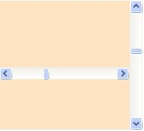
ScrollBar
Allow a value to be selected from a range
They show a track, indicating the range and a draggable "thumb"
The ScrollBar control is commonly used in conjunction with some scrolling viewable area
Control the size of a scroll bar’s thumb with the ViewportSize property

Slide 25

Slider
Slider control is used to adjust values
Slider and ScrollBar have an Orientation property
They both derive from a common base class, RangeBase
Provides Minimum and Maximum, SmallChange and LargeChange properties

Slide 26

ProgressBar
Helps user realize that progress is indeed being made
ProgressBar has a default Minimum of 0 and a default Maximum of 100
IsIndeterminate property
True - ProgressBar shows a generic animation
Orientation property
Horizontal by default

Slide 27


Tooltip
Allows a floating label to be displayed above some part of the user interface
To associate a ToolTip with its target element set it as the ToolTip property of its target
<TextBox Width="147" Height="25">
<TextBox.ToolTip>
<ToolTip Content="Type something here" />
</TextBox.ToolTip> <!--The result is-->
</TextBox>

Slide 28
GridView
Has a Columns content property
Columns can be reordered by dragging and dropping them in the built application
Columns can be resized
Columns can automatically resize to "just fit"

Slide 29
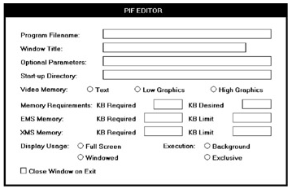
Activity – Problems?

Slide 30
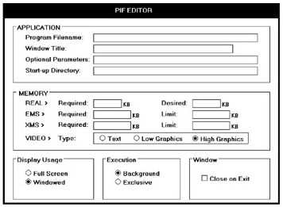
Activity - Improvement

